Slide 1
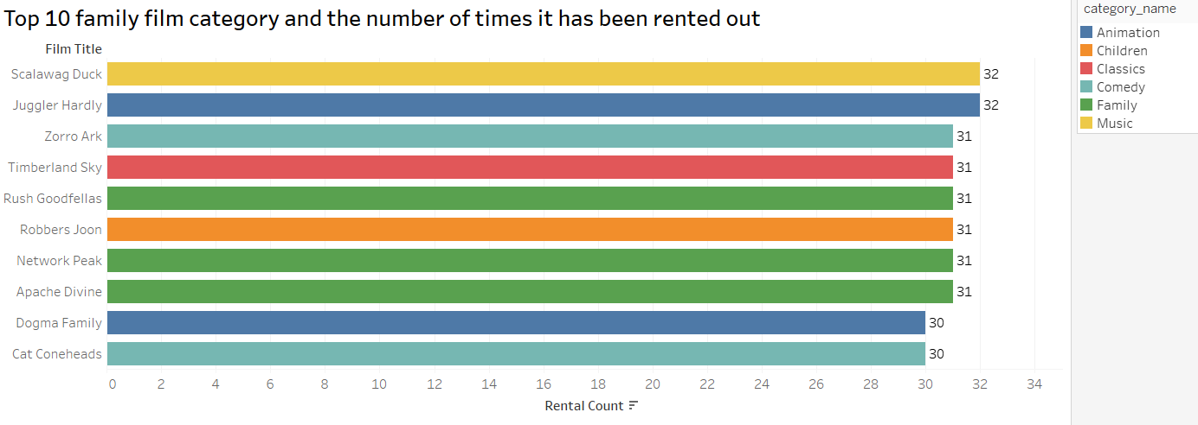
Lists top 10 family film category and the number of times it has been rented out. (The following categories are considered family movies: Animation, Children, Classics, Comedy, Family and Music)
From the visualization, the top films that have been rented out are Scalawag Duck and Juggler Hardly, which is in music and animation category respectively. From the list, family category (green color) has the most spot on the list (3 out of 10).

Slide 2
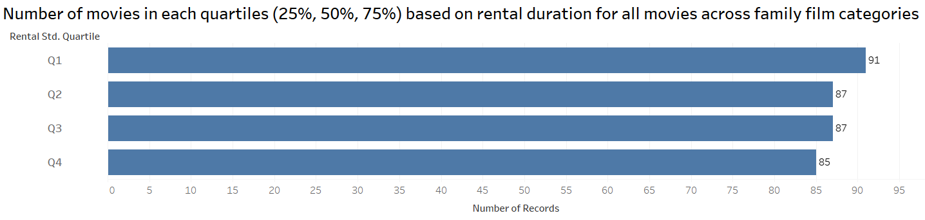
Of All films that are categorized in family film category, how many movies are there based on each quartiles (25%, 50%, 75%) of the rental duration for movies across all categories? And what was the range of rental count in each quartile?*
Quartile | Rental Count range
Q1 | 24
Q2 | 27
Q3 | 26
Q4 | 27
From the visualization, quartile 1 (low rental duration) has the highest number rental duration records; however, it has the least rental count range. While number of records in other quartiles (high rental duration) are slightly lower than Q1’s, all of them have almost the same rental count range (26, 27).
* Note: This table is calculated after obtaining query results

Slide 3
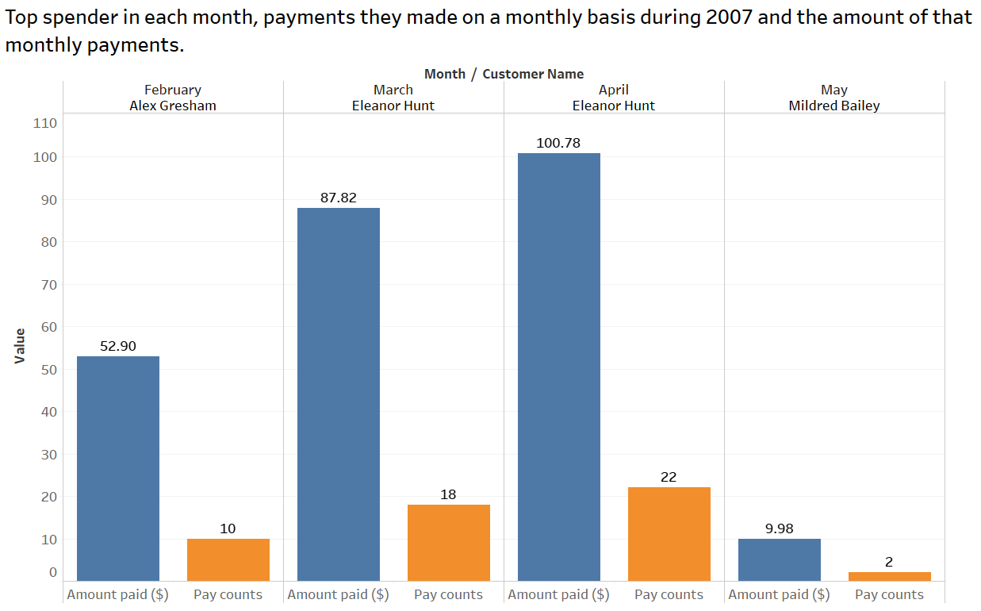
Who was top spender in each month, how many payments they made on a monthly basis during 2007 and what was that amount?
Only data from February to May during 2007 are presented in the dataset. Both amount paid and number of pay counts in each month is in upward trend from February to April. However, both figures decreased dramatically in May. Note that for both March and April, Eleanor Hunt is the top spender for two consecutive months with both amount paid and number of pay counts in each month increased from March to April as well.

Slide 4
How was transaction record per month for each top spender?
Continue from last visualization, the line graph shows how much Alex Gresham, Eleanor Hunt and Mildred Bailey spent in each month. Only Eleanor Hunt (Orange line) spent more compared to previous months and Mildred Bailey (Gray line) is the only customer who spends on May and also the top spender for this month.
Amount paid ($)
Month

